Slide 1
CZECH BIOFUELS TECHNOLOGY PLATFORM
CO₂ - Source for Chemical Industry and Transport
CO₂ – SChIT
IDEA českého národního projektu - MISE
CZECH MISSION
DEMONSTRAČNÍ CENTRUM TRANSFORMAČNÍCH TECHNOLOGIÍ CO2 & P2X
Leos Gal The Head of Steering Committee
Czech Biofuels Technology Platform
leos.gal@seznam.cz
00420-736505012
Technologické centrum
Akademie věd
7. 3. 2019

Slide 2
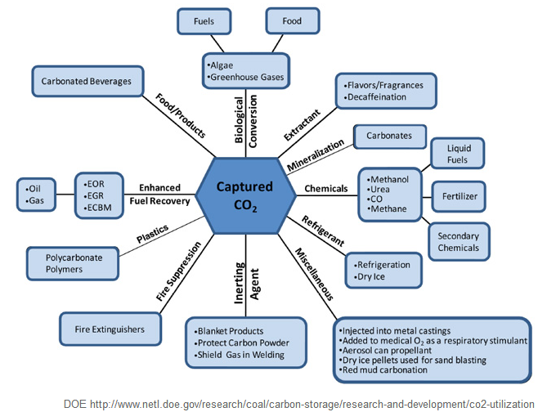
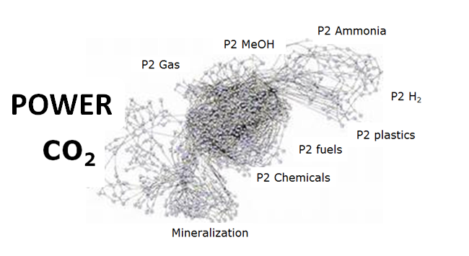
Racionální cesta řešení jednoduchého problému
Problematika CO2 je komplikovanější (replikace fotosyntézy)
Fotosyntéza - extrémně složité proteinové struktury na základě přesně definovaného atomového uspořádání
Je obtížná laboratorní replikace – nutné je dodávání energie !!!
Biologie
Biochemie
Biofyzika
Chemie
Fyzikální chemie
Elektrotechnika
Chemická technologie
Energetika (komplex)

Slide 3
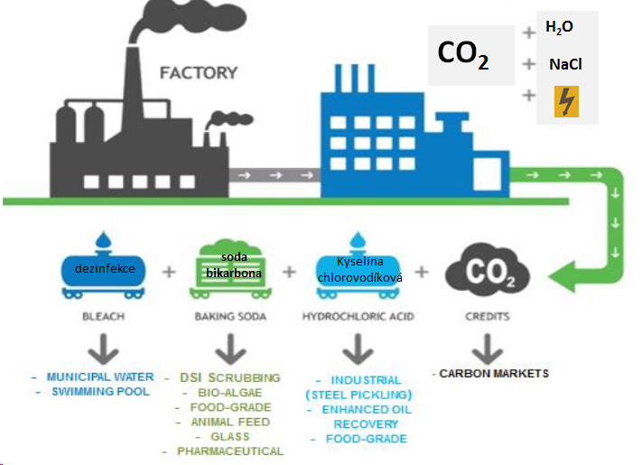
Fundamentální předpoklad úspěšnosti transformace CO2
K transformaci inertní molekuly CO2 nutné je dodávání energie !!!
EU ETS
price
1 t CO2
Nákladová položka

Slide 4
Climate-Kic
CO2 transformation in Europe – SERIA a JAP
PALIVA
TRL
3 - 8
PLASTY
TRL
4 - 8
CEMENT
TRL
8 - 9

Slide 5
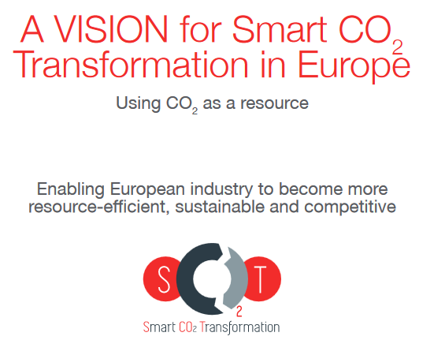
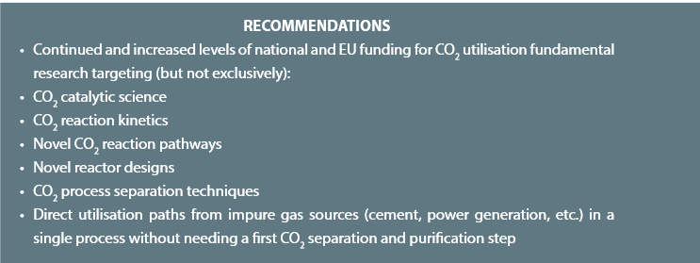
EU Activity - EUROPEAN INSTITUT of INNOVATION & TECHNOLOGY
EIT Climate-KIC
EIT Climate-KIC
Climate change mitigation and adaptation
EIT Digital:
EIT Food:
EIT Health:
EIT InnoEnergy:
EIT Raw Materials:
Information and Communication Technologies
Food innovation and production
Healthy living and active ageing
Sustainable energy
Exploration, extraction, processing, recycling and substitution
A Strategic European Research and Innovation Agenda for Smart CO2 Transformation in Europe (SERIA)
SHARED EUROPEAN
MODULAR PILOT PLANTS
and
VERIFICATION CENTRES
http://www.scotproject.org/images/SCOT%20Vision.pdf
Notes:
Přesunout do rezervy na konec přednášky

Slide 6
SHARED EUROPEAN
MODULAR PILOT PLANTS and
VERIFICATION CENTRE
CZECH TECHNOLOGICAL CO₂ TRANSFORMATION CENTRE
3 PILLARS
1. CARBON CAPTURE STORAGE – CCS CO₂ Capturing
2. ELECTROLYSIS/ membrane separation H₂ Production/Storage
3. DEMONSTRATION OF TECHNOLOGICAL POSSIBILITIES CO₂ + H₂ to Chemicals
Power to Chemicals
Chemicals to Power

Slide 7
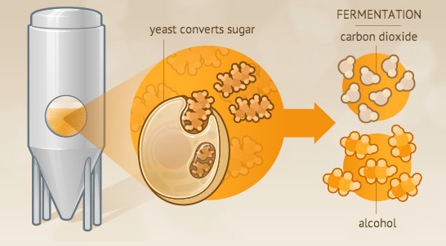
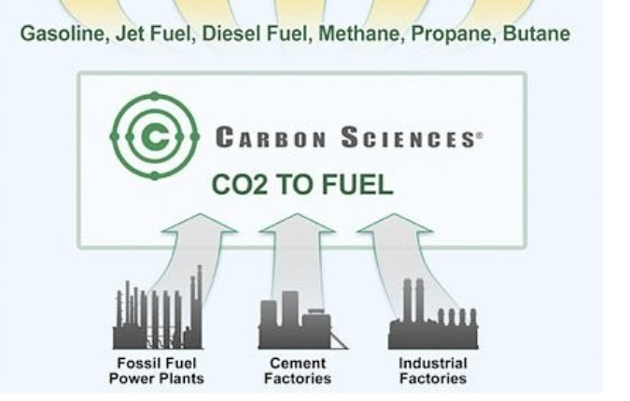
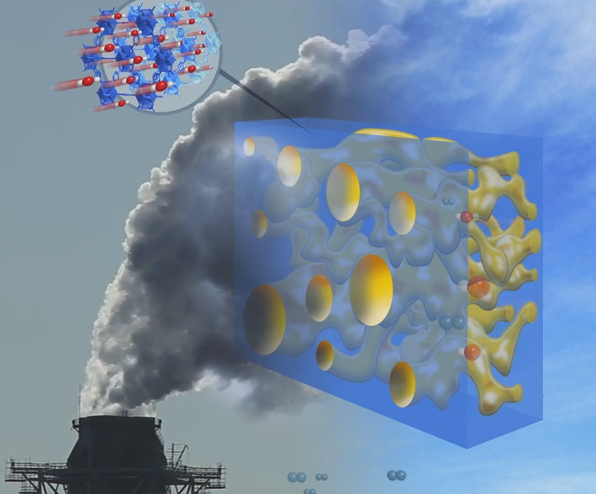
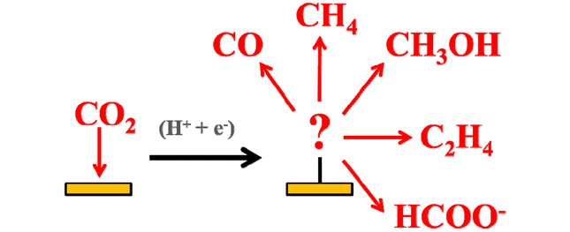
CARBON CAPTURE STORAGE for next following UTILIZATION
1st STAGE
2nd STAGE
1st STAGE
2nd STAGE
Čisté CO2
potravinářská kvalita
bezproblémové pro CCSU
Průměr EU – 8,7 t CO₂ ekv./obyv.
Průměr ČR – 12,4 t CO₂ ekv./obyv
https://markets.businessinsider.com/commodities/co2-emissionsrechte

Slide 8
AKER SOLUTION – NORWAY Technology Centre Mongstad (TCM)
Jednáme, chtějí spolupracovat
Návštěva TCM 2019
National CCS demo project within 2022: NORCEM - cement plant Zero CO2 Emission Vision 2030
YARA - ammonia plant
KLEMETSRUD - (W-t-E)
https://tu-freiberg.de/sites/default/files/media/professur-fuer-energieverfahrenstechnik-und-thermische-rueckstandsbehandlung-16460/publikationen/28-1-co2_capture_technologies_berlin_6_june_2018_final_version.pdf
https://static1.squarespace.com/static/574c47228259b5de6737fbfe/t/5afd206303ce64542a64c5a5/1526538349706/6.+Graff+CCUS+in+Aker+Solutions.pdf

Slide 9
SHARED EUROPEAN
MODULAR PILOT PLANTS and
VERIFICATION CENTRE
CZECH TECHNOLOGICAL CO₂ TRANSFORMATION CENTRE
3 PILLARS
1. CARBON CAPTURE STORAGE – CCS CO₂ Capturing
2. ELECTROLYSIS/ membrane separation H₂ Production/Storage
3. DEMONSTRATION OF TECHNOLOGICAL POSSIBILITIES CO₂ + H₂ to Chemicals
Power to Chemicals
Chemicals to Power

Slide 10
Cesta k levnému vodíku jak ji vidí NORWAY
(LCOE – Levelized Cost of Energy) Sdružená cena energie - zohledňuje náklady v průběhu celého životního cyklu produkce
https://nelhydrogen.com/assets/uploads/2019/01/Nel-ASA-Company-presentation-Jan-2019.pdf

Slide 11
SHARED EUROPEAN
MODULAR PILOT PLANTS and
VERIFICATION CENTRE
CZECH TECHNOLOGICAL CO₂ TRANSFORMATION CENTRE
3 PILLARS
1. CARBON CAPTURE STORAGE – CCS CO₂ Capturing
2. ELECTROLYSIS/ membrane separation H₂ Production/Storage
3. DEMONSTRATION OF TECHNOLOGICAL POSSIBILITIES CO₂ + H₂ to Chemicals
Power to Chemicals
Chemicals to Power

Slide 12
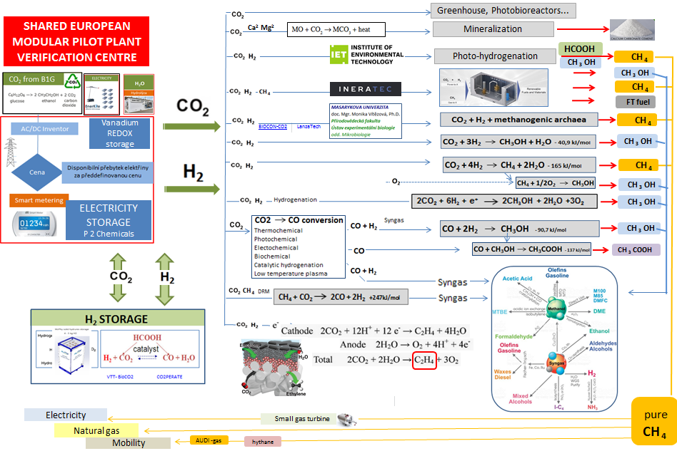
CO₂ VERIFICATION CENTRE - summarizing of the demonstration plants
CO₂ Biological - soil & plants sequestration
CO₂ Mineralization
DIRECT
CO₂ CONVERSION
CO₂ - Electricity - H₂O (H₂)
INNOVATION
SMART ELECTRICITY MANAGEMENT
- Distribution - grid
- BATTERY
- V2G
- P2 Chemicals
- P2 Hydrogen
- e - mobility
- g - mobility
INDIRECT
CO₂ CONVERSION
HYDROGEN STORAGE
GAS GRID and Methane mobility

Slide 13
SHARED EUROPEAN
MODULAR PILOT PLANTS and
VERIFICATION CENTRE
CZECH TECHNOLOGICAL CO₂ TRANSFORMATION CENTRE
3 PILLARS
I. STAGE - Summarizing of the demonstration plants
II. STAGE - DEVELOPMENT SCIENCE R&D&I
1. CARBON CAPTURE STORAGE – CCS CO₂ Capturing
2. ELECTROLYSIS/ membrane separation H₂ Production/Storage
3. DEMONSTRATION OF TECHNOLOGICAL POSSIBILITIES CO₂ + H₂ to Chemicals
Power to Chemicals
Chemicals to Power

Slide 14
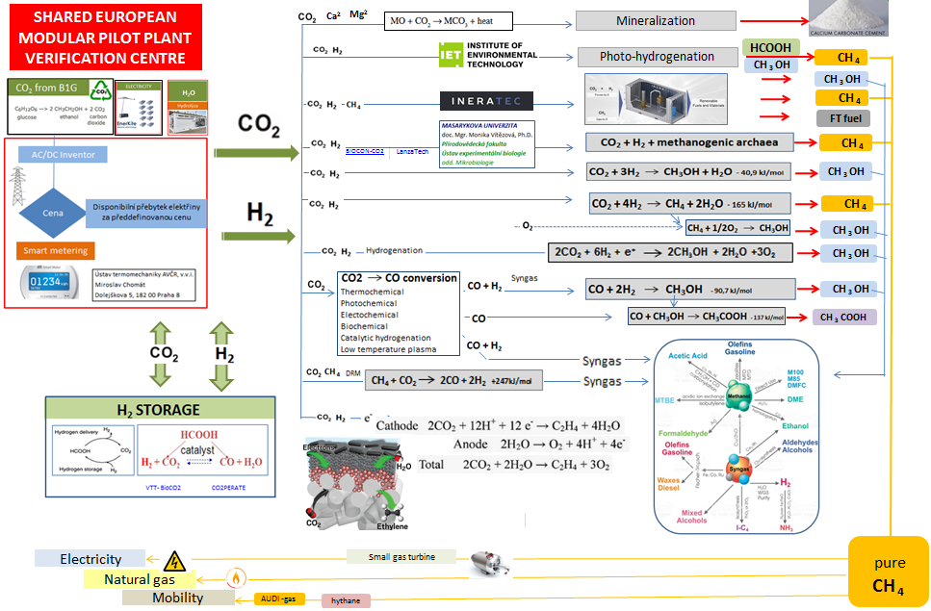
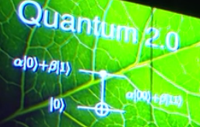
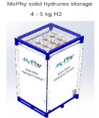
CO₂ VERIFICATION CENTRE
SCIENCE - R&D&I
CO₂ NATURAL BIOLOGICAL SEQUESTRATION, BECCS
Vegetal ecosystem role in CO2 capture
CO₂ MINERALIZATION
EU FLAGSHIP - GRAPHENE
NDGQs -Nitrogen-Doped Graphene Quantum dots
Liquid fuels CH₃CH₂OH, C₂H₂,…..
CCS membrane CO₂/N₂
RES development
CO₂ - Electricity - H₂O (H₂)
Quantum Photo - Engineered Catalysts
Photo – electrochemical – H2 production
Photolysis
INNOVATION
SMART ELECTRICITY MANAGEMENT
- Distribution - grid
- BATTERY
- V2G
- P2 Chemicals
- P2 Hydrogen
- e - mobility
- g - mobility
QUANTUM ENERGY (PEC – Photo electrochemical cells, Photosensitizer compounds, Photocatalysts, Artificial leaf…)
Vanadium
REDOX
storage
MICROBIOLOGY DEVELOPMENT
GENETICS, PBE - Photo bio electrochemical systems
bacteria interaction with electrodes by exchanging electrons, directly or via redox mediators
Thermomechanical, Plasmolysis,…
INDIRECT CO₂ CONVERSION PROGRESS
P2A2P (NH₃)
Ammonia economy
Power to Ammonia
Nitrogen-Hydrogen
H₂
development
HER hydrogen evolution reaction
H₂ Storage
H₂ FUEL CELLS
PEC photo electrochemical cells
NG - ENERGY OUTPUT

Slide 15
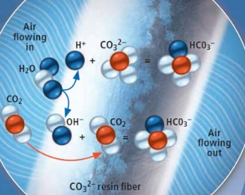
TOP SCIENCE
New and immature technologies CO₂ capture
- Permeable membrane materials MOF (Metal organic framework) ZIF (zeolite) COF (covalent)…
- Molten Carbonate
- High-pressure combustion with solvent capture
- Supersonic separator
- DAC – Direct Air Capture
Ceramic, Polymeric (spiral-wound, envelope, hollow, hybrid aminopolymer) PEI polyethyleneimine (MCM 41)
TFC-Thin Film Composite PDMS-PolyDiMethylSiloxane PEO- PolyEthylene Oxide EO-Ethylene Oxide
PEBAX -PA-polyamid+PB polyether PBT-Poly(Butylene Terephthalate) PBT+PEO,….
https://www.researchgate.net/publication/264615211_Highly_permeable_membrane_materials_for_CO2_capture https://www.researchgate.net/publication/286409831_Hybrid_aminopolymer-silica_materials_for_efficient_CO2_adsorption
MCFCs ( > 600°C - Allow capture CO₂ and produce power at the same time)
Combined Electric Power and CO2 Separation (CEAPCS) COAL 2 POWER (integrace SOFC) efficiency 45-50%
https://www.wyoleg.gov/InterimCommittee/2017/09-0629APPENDIXF-1.pdf
https://www.sciencedirect.com/science/article/abs/pii/S1750583612001053
https://ac.els-cdn.com/S1876610217313851/1-s2.0-S1876610217313851-main.pdf?_tid=2c25eaee-6750-4d86-9fcd-db09d93c4090&acdnat=1540734522_f9718030ed4393c68c63536b77e3ce47
Primary amines (MAE,EDA), Secondary amines (DEA,DIPA) , Tertiary amines (MDEA,TEA) , Hindered amines (AMP, 2-PE)
Polyamines (PZ,HEP) Alkali carbonates (K₂CO₃, Na₂CO₃) Ammonia (NH₃) Amino acid salts,
Ionic Liquids ([bmim]-BF₄) [bmim]-PF₆) Deep eutectic solvents (Choline chloride (ChCl)/MEA Choline chloride (ChCl)/urea)
https://www.researchgate.net/publication/323753367_Solvent_Development_for_Post-Combustion_CO_2_Capture_Recent_Development_and_Opportunities
High-pressure solvent capture with exhaust gas compression
Vysokotlaká absorpce rozpouštědla podporovaná kompresí výfukových plynů
Novel CO2 condensation and separation in supersonic flows contributing to carbon capture and storage (CCS)
https://cordis.europa.eu/project/rcn/213958_en.html UK + TU DENMARK
Moisture Swing Air Capture Technology filter=panels made of sorbent material
BICC – Buiding Integrated Carbon Capturing integrate CC technology onto building facades.
Na bázi iontoměničové pryskyřice
http://www.hrpub.org/download/20180530/CEA5-14811595.pdf
https://ac.els-cdn.com/S1876610217316041/1-s2.0-S1876610217316041-main.pdf?_tid=1cbfbebb-c11d-4fb1-ba00-ef7ee040cdf3&acdnat=1543944493_1121b0918217ac298c1c30d2c2261f9a

Slide 16
CO₂ VERIFICATION CENTRE
SCIENCE - R&D&I
CO₂ NATURAL BIOLOGICAL SEQUESTRATION, BECCS
Vegetal ecosystem role in CO2 capture
CO₂ MINERALIZATION
EU FLAGSHIP - GRAPHENE
NDGQs -Nitrogen-Doped Graphene Quantum dots
Liquid fuels CH₃CH₂OH, C₂H₂,…..
CCS membrane CO₂/N₂
RES development
Quantum Photo - Engineered Catalysts
Photo – electrochemical – H2 production
Photolysis
INNOVATION
SMART ELECTRICITY MANAGEMENT
- Distribution - grid
- BATTERY
- V2G
- P2 Chemicals
- P2 Hydrogen
- e - mobility
- g - mobility
QUANTUM ENERGY (PEC – Photo electrochemical cells, Photosensitizer compounds, Photocatalysts, Artificial leaf…)
Vanadium
REDOX
storage
MICROBIOLOGY DEVELOPMENT
GENETICS, PBE - Photo bio electrochemical systems
bacteria interaction with electrodes by exchanging electrons, directly or via redox mediators
Thermomechanical, Plasmolysis,…
INDIRECT CO₂ CONVERSION PROGRESS
P2A2P (NH₃)
Ammonia economy
Power to Ammonia
Nitrogen-Hydrogen
H₂
development
HER hydrogen evolution reaction
H₂ Storage
H₂ FUEL CELLS
PEC photo electrochemical cells
NG - ENERGY OUTPUT

Slide 17
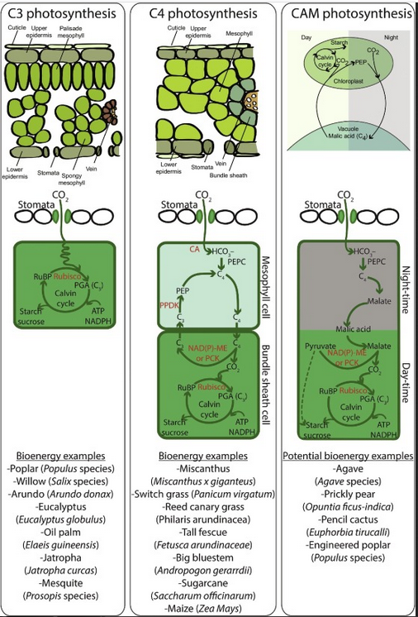
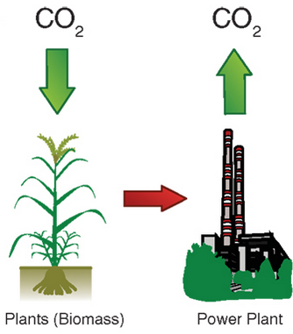
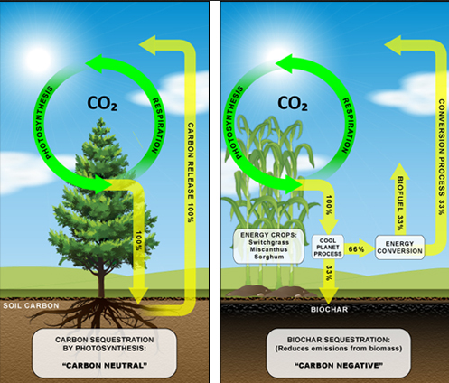
TOP SCIENCE
BECC – Bio CCS
Biogenic Carbon Capture and Sequestration
CO₂ s ribulosou-1,5-bisfosfátem za katalýzy enzymem RuBisCO vznikají 2 molekuly 3-fosfoglycerátu.
Reakce probíhá v temnostní fázi fotosyntézy v Calvinově cyklu.

Slide 18
CO₂ VERIFICATION CENTRE
SCIENCE - R&D&I
Vegetal ecosystem role in CO2 capture
CO₂ MINERALIZATION
EU FLAGSHIP - GRAPHENE
NDGQs -Nitrogen-Doped Graphene Quantum dots
Liquid fuels CH₃CH₂OH, C₂H₂,…..
CCS membrane CO₂/N₂
RES development
Quantum Photo - Engineered Catalysts
Photo – electrochemical – H2 production
Photolysis
INNOVATION
SMART ELECTRICITY MANAGEMENT
- Distribution - grid
- BATTERY
- V2G
- P2 Chemicals
- P2 Hydrogen
- e - mobility
- g - mobility
QUANTUM ENERGY (PEC – Photo electrochemical cells, Photosensitizer compounds, Photocatalysts, Artificial leaf…)
Vanadium
REDOX
storage
MICROBIOLOGY DEVELOPMENT
GENETICS, PBE - Photo bio electrochemical systems
bacteria interaction with electrodes by exchanging electrons, directly or via redox mediators
Thermomechanical, Plasmolysis,…
INDIRECT CO₂ CONVERSION PROGRESS
P2A2P (NH₃)
Ammonia economy
Power to Ammonia
Nitrogen-Hydrogen
H₂
development
HER hydrogen evolution reaction
H₂ Storage
H₂ FUEL CELLS
PEC photo electrochemical cells
NG - ENERGY OUTPUT

Slide 19
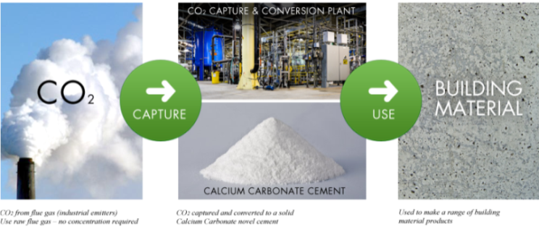
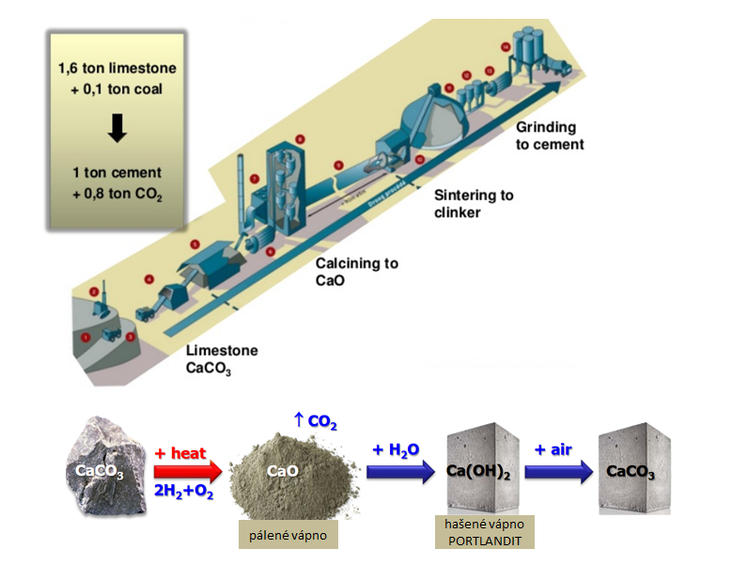
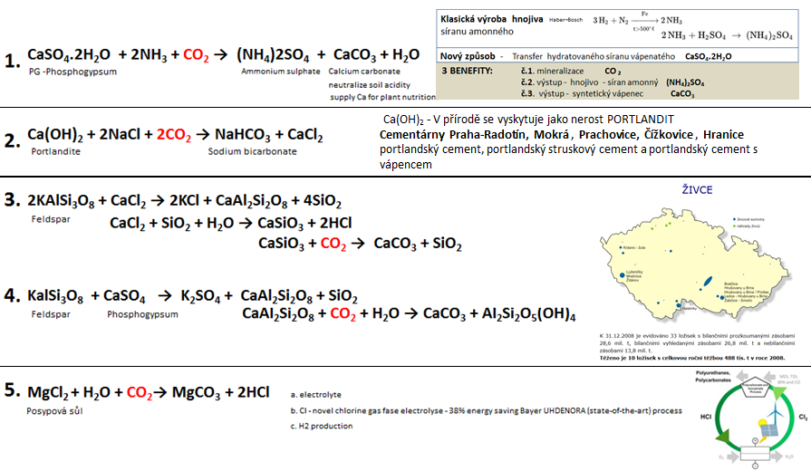
TOP SCIENCE
CO₂ mineralization
- AGRO Industry (NH₄) ₂SO₄
- Building Industry CaCO₃, Geopolymery
- Food Industry E 170, NaHCO₃…
- Chemical Industry NaClO, HCl, Na₂CO₃,…
Advantage impurities
tolerance
(NH₄)₂SO₄
CaCO_{3 …}
E 170, NaHCO_{3…..}
NaClO , HCl, Na₂CO_{3 ….}
https://www.sciencedirect.com/science/article/pii/S2212982014000626

Slide 20
CO₂ VERIFICATION CENTRE
SCIENCE - R&D&I
Vegetal ecosystem role in CO2 capture
EU FLAGSHIP - GRAPHENE
NDGQs -Nitrogen-Doped Graphene Quantum dots
Liquid fuels CH₃CH₂OH, C₂H₂,…..
CCS membrane CO₂/N₂
RES development
Quantum Photo - Engineered Catalysts
Photo – electrochemical – H2 production
Photolysis
INNOVATION
SMART ELECTRICITY MANAGEMENT
- Distribution - grid
- BATTERY
- V2G
- P2 Chemicals
- P2 Hydrogen
- e - mobility
- g - mobility
QUANTUM ENERGY (PEC – Photo electrochemical cells, Photosensitizer compounds, Photocatalysts, Artificial leaf…)
Vanadium
REDOX
storage
MICROBIOLOGY DEVELOPMENT
GENETICS, PBE - Photo bio electrochemical systems
bacteria interaction with electrodes by exchanging electrons, directly or via redox mediators
Thermomechanical, Plasmolysis,…
INDIRECT CO₂ CONVERSION PROGRESS
P2A2P (NH₃)
Ammonia economy
Power to Ammonia
Nitrogen-Hydrogen
H₂
development
HER hydrogen evolution reaction
H₂ Storage
H₂ FUEL CELLS
PEC photo electrochemical cells
NG - ENERGY OUTPUT

Slide 21
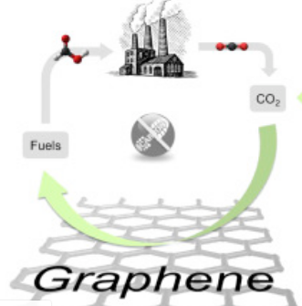
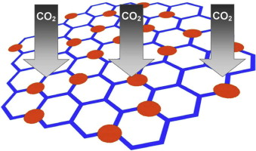
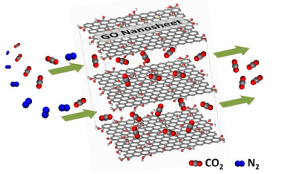
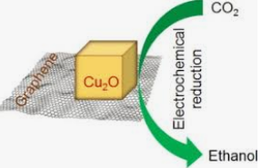
TOP SCIENCE
GRAPHENE and derivates
- CCS
- Convertion CO2 to fuels
- Convertion CO2 to graphen
CO₂ capture
- mesoporous TiO₂/graphene oxide nanocomposites
- selective Gas-Transport Channels of Laminar Graphene Oxide
Graphene - fuels
CO2 to Graphene
CVMR® and EnerCarbon® have been able to Capture CO2 that is emitted from various industrial outlets and convert the captured CO2 into value-added products with a high level of market demand such as graphite and graphene.

Slide 22
CO₂ VERIFICATION CENTRE
SCIENCE - R&D&I
Vegetal ecosystem role in CO2 capture
NDGQs -Nitrogen-Doped Graphene Quantum dots
Liquid fuels CH₃CH₂OH, C₂H₂,…..
CCS membrane CO₂/N₂
RES development
Quantum Photo - Engineered Catalysts
Photo – electrochemical – H2 production
Photolysis
INNOVATION
SMART ELECTRICITY MANAGEMENT
- Distribution - grid
- BATTERY
- V2G
- P2 Chemicals
- P2 Hydrogen
- e - mobility
- g - mobility
QUANTUM ENERGY (PEC – Photo electrochemical cells, Photosensitizer compounds, Photocatalysts, Artificial leaf…)
Vanadium
REDOX
storage
MICROBIOLOGY DEVELOPMENT
GENETICS, PBE - Photo bio electrochemical systems
bacteria interaction with electrodes by exchanging electrons, directly or via redox mediators
Thermomechanical, Plasmolysis,…
INDIRECT CO₂ CONVERSION PROGRESS
P2A2P (NH₃)
Ammonia economy
Power to Ammonia
Nitrogen-Hydrogen
H₂
development
HER hydrogen evolution reaction
H₂ Storage
H₂ FUEL CELLS
PEC photo electrochemical cells
NG - ENERGY OUTPUT

Slide 23
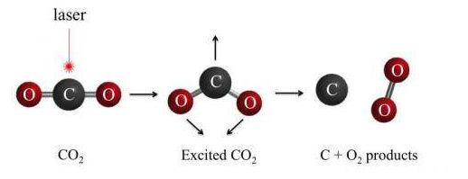
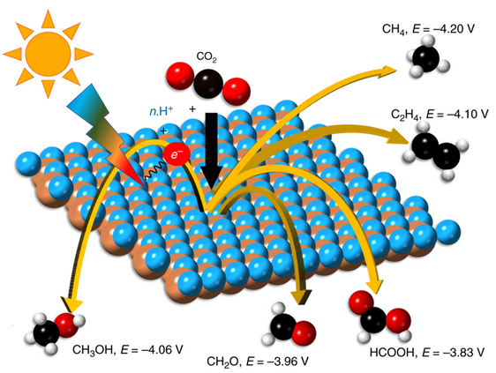
TOP SCIENCE
Photocatalytic conversion CO₂
photon – quantum of light
(or other form of electromagnetic radiation)
Výzvy:
1.Laser
2.Foto katalyzátory: heterogenní bimetalické sloučeniny nebo cross-linked materiály C₃N₄
3.Bipolární membrány
https://www.nature.com/articles/s41467-019-08356-1

Slide 24
CO₂ VERIFICATION CENTRE
SCIENCE - R&D&I
Vegetal ecosystem role in CO2 capture
NDGQs -Nitrogen-Doped Graphene Quantum dots
Liquid fuels CH₃CH₂OH, C₂H₂,…..
CCS membrane CO₂/N₂
RES development
INNOVATION
SMART ELECTRICITY MANAGEMENT
- Distribution - grid
- BATTERY
- V2G
- P2 Chemicals
- P2 Hydrogen
- e - mobility
- g - mobility
Quantum Photo - Engineered Catalysts
Photo – electrochemical – H2 production
Photolysis
Vanadium
REDOX
storage
Metabolic engineering, PBE-Photo Bio Electrochemical systems,
MES - Microbial Electro Synthesis
bacteria interaction with electrodes by exchanging electrons,
MICROBIOLOGY DEVELOPMENT
Thermomechanical, Plasmolysis,…
INDIRECT CO₂ CONVERSION PROGRESS
P2A2P (NH₃)
Ammonia economy
Power to Ammonia
Nitrogen-Hydrogen
H₂
development
HER hydrogen evolution reaction
H₂ Storage
H₂ FUEL CELLS
PEC photo electrochemical cells
NG - ENERGY OUTPUT

Slide 25
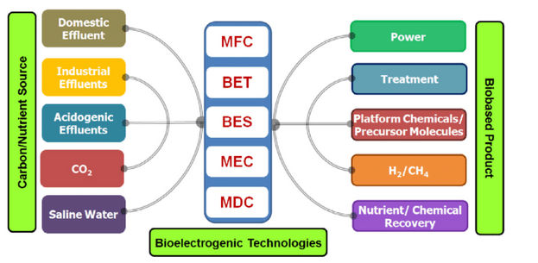
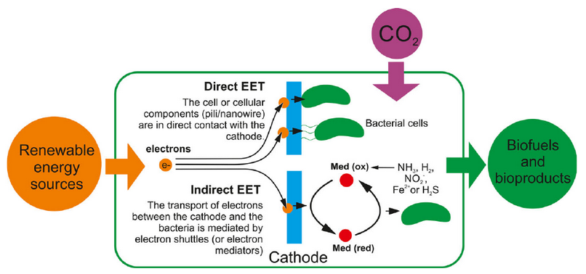
TOP SCIENCE
Microbial CO₂ conversion
- Metabolism of microorganisms
- Electroactive bacteria,….
Microbial chemistry - young technology - progress in the last 5 years
EET - Extracellular Electron Transfer
MFC - Microbial fuel cells
BET - Bio electrochemical treatment system
BES - Bio electrochemical system
MEC - Microbial electrolysis cell
MDC - Microbial desalination cell
https://www.researchgate.net/publication/319108164_About_how_to_capture_and_exploit_the_CO_2_surplus_that_nature_per_se_is_not_capable_of_fixing
https://www.ncbi.nlm.nih.gov/pmc/articles/PMC6011938/figure/mbt213270-fig-0002/

Slide 26
CO₂ VERIFICATION CENTRE
SCIENCE - R&D&I
Vegetal ecosystem role in CO2 capture
NDGQs -Nitrogen-Doped Graphene Quantum dots
Liquid fuels CH₃CH₂OH, C₂H₂,…..
CCS membrane CO₂/N₂
RES development
INNOVATION
SMART ELECTRICITY MANAGEMENT
- Distribution - grid
- BATTERY
- V2G
- P2 Chemicals
- P2 Hydrogen
- e - mobility
- g - mobility
Quantum Photo - Engineered Catalysts
Photo – electrochemical – H2 production
Photolysis
Vanadium
REDOX
storage
Metabolic engineering, PBE-Photo Bio Electrochemical systems,
MES - Microbial Electro Synthesis
bacteria interaction with electrodes by exchanging electrons,
Thermomechanical, Plasmolysis,…
INDIRECT CO₂ CONVERSION PROGRESS
P2A2P (NH₃)
Ammonia economy
Power to Ammonia
Nitrogen-Hydrogen
H₂
development
HER hydrogen evolution reaction
H₂ Storage
H₂ FUEL CELLS
PEC photo electrochemical cells
NG - ENERGY OUTPUT

Slide 27
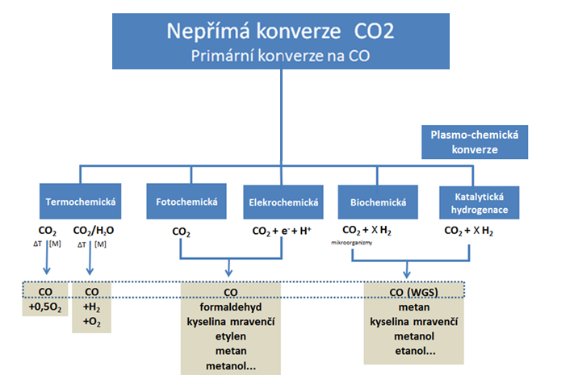
TOP SCIENCE
Indirect CO₂ conversion
Primarily to CO
- Thermochemical
- Photochemical
- Electrochemical
- Biochemical
- Catalytic hydrogenation
- Low temperature plasma

Slide 28
CO₂ VERIFICATION CENTRE
SCIENCE - R&D&I
Vegetal ecosystem role in CO2 capture
NDGQs -Nitrogen-Doped Graphene Quantum dots
Liquid fuels CH₃CH₂OH, C₂H₂,…..
CCS membrane CO₂/N₂
RES development
INNOVATION
SMART ELECTRICITY MANAGEMENT
- Distribution - grid
- BATTERY
- V2G
- P2 Chemicals
- P2 Hydrogen
- e - mobility
- g - mobility
Quantum Photo - Engineered Catalysts
Photo – electrochemical – H2 production
Photolysis
Vanadium
REDOX
storage
Metabolic engineering, PBE-Photo Bio Electrochemical systems,
MES - Microbial Electro Synthesis
bacteria interaction with electrodes by exchanging electrons,
Thermomechanical, Plasmolysis,…
P2A2P (NH₃)
Ammonia economy
Power to Ammonia
Nitrogen-Hydrogen
H₂
development
HER hydrogen evolution reaction
H₂ Storage
H₂ FUEL CELLS
PEC photo electrochemical cells
NG - ENERGY OUTPUT

Slide 29
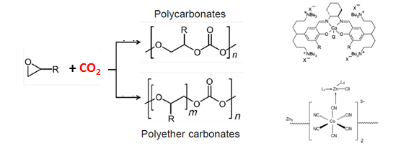
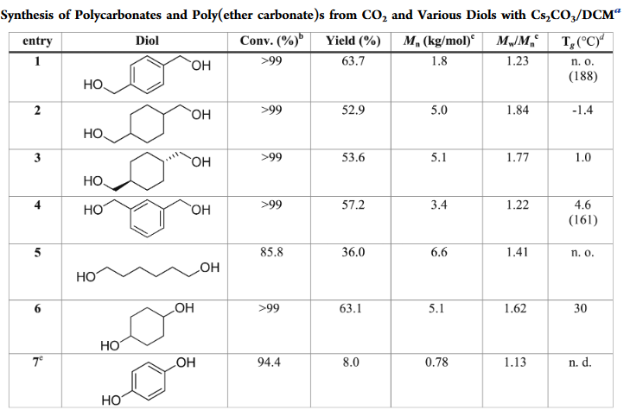
TOP SCIENCE
POLYMERS
- Polycarbonates
- Ethylenglycol - for PEG,PET
- Methylglyoxal – formaldehyde replacement
- Furandiol – fuels additive
- etc….
Synthesis of Polycarbonates – Polyether carbonates
Monoethylen glycol
PEG,PET
Náhrada formaldehydu
Methylglyoxal
Fuel additive
Furandiol
COVESTRO - Bayer Material Science
cardyon® - Polyuretanové pěny
https://pubs.acs.org/doi/pdf/10.1021/acsomega.6b00278

Slide 30
CO₂ VERIFICATION CENTRE
SCIENCE - R&D&I
Vegetal ecosystem role in CO2 capture
NDGQs -Nitrogen-Doped Graphene Quantum dots
Liquid fuels CH₃CH₂OH, C₂H₂,…..
CCS membrane CO₂/N₂
RES development
INNOVATION
SMART ELECTRICITY MANAGEMENT
- Distribution - grid
- BATTERY
- V2G
- P2 Chemicals
- P2 Hydrogen
- e - mobility
- g - mobility
Quantum Photo - Engineered Catalysts
Photo – electrochemical – H2 production
Photolysis
Vanadium
REDOX
storage
Metabolic engineering, PBE-Photo Bio Electrochemical systems,
MES - Microbial Electro Synthesis
bacteria interaction with electrodes by exchanging electrons,
Thermomechanical, Plasmolysis,…
P2A2P (NH₃)
Ammonia economy
HER hydrogen evolution reaction
H₂ Storage
H₂ FUEL CELLS
PEC photo electrochemical cells
HYDROGEN
NG - ENERGY OUTPUT

Slide 31
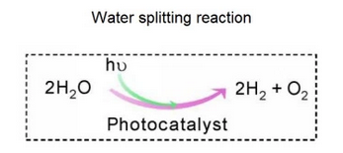
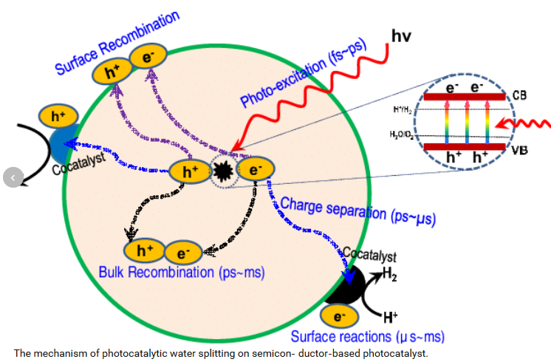
TOP SCIENCE
HYDROGEN
- HER ( Hydrogen Evolution Reaction)
- Storage HCOOH, NH₃,…
HER – Hydrogen Evolution Reaction
unique parallel reactions
Ru₂ P nanoparticles
Ni₅P₄ microparticles
single atom catalysts (SACs)
HYDROGEN STORAGE
1 l formic acid = 590 l hydrogen
Photocatalysts for solar water splitting (no electrolysis way)
https://www.mdpi.com/2076-3417/8/6/914/pdf

Slide 32
CO₂ VERIFICATION CENTRE
SCIENCE - R&D&I
Vegetal ecosystem role in CO2 capture
NDGQs -Nitrogen-Doped Graphene Quantum dots
Liquid fuels CH₃CH₂OH, C₂H₂,…..
CCS membrane CO₂/N₂
RES development
INNOVATION
SMART ELECTRICITY MANAGEMENT
- Distribution - grid
- BATTERY
- V2G
- P2 Chemicals
- P2 Hydrogen
- e - mobility
- g - mobility
Quantum Photo - Engineered Catalysts
Photo – electrochemical – H2 production
Photolysis
Vanadium
REDOX
storage
Metabolic engineering, PBE-Photo Bio Electrochemical systems,
MES - Microbial Electro Synthesis
bacteria interaction with electrodes by exchanging electrons,
Thermomechanical, Plasmolysis,…
P2A2P (NH₃)
Ammonia economy
HER hydrogen evolution reaction
H₂ Storage
H₂ FUEL CELLS
PEC photo electrochemical cells
NG - ENERGY OUTPUT

Slide 33
TOP SCIENCE
Create connected energy management system
RES – Power distribution (storage) – H2 – Chemicals – Fuels – Grid - on time

Slide 34
CO₂ VERIFICATION CENTRE - FUNDAMENTS for GREEN CARBON INDUSTRY
CO2 - ČEZ, EON, EPH,
Třinecké železárny
Acelor Mital, Lafarge, ….
VŠCHT.Lab nízkoteplotního plazmatu doc. Ing. Vladimír Scholtz, Ph.D.
VŠB TUO Faculty of Materials Science and Technology
NG - EON, ČEZ, ČEPS, innogy Gas Storage , MND , SPP Bohemia

Slide 35
GOALS - VERIFICATION CENTER of CO₂ TRANSFORMATIONS in CZECH REPUBLIC
POLITICAL - Reaction to IPCC (aiming science to CO₂ due to Paris agreement results)
- Czech Republic FIRST PLACE position - industry (share per head in EU)
- Long term Czech chemical history and science background
- Czech Republic - geographical focus point of EU
2. SYSTEMATIZATION
Pilot (demo) R&D projects (founded by EU) concentration in one place
(R&D history, outlook , pathways upscale, LCA, effectivity, advantage-disadvantage of particular routs, social impact, bottlenecks…)
3. Confrontation/competition between different pathways
GWI - (Global Warming Impact) RMI - (Raw material input) TMR - (Total material input)
CED - (Cumulative energy demand) WI - (water input) CTE- (Carbon transfer efficiency) …… Upscale Limits, Economy
4. EDUCATION - EXPOSITION
Running (and upcoming) pathways demonstration = EU CO₂ policy - shop window
(involve students, public - excursion,… running transformation in reality and audio-video program about next CO₂ pathway potential )
5. R&D – small scale testing FLEXIBILITY (impurities, effectivity, catalytic issues, clones, ... )
6. Czech know-how INNOVATIVE - Smart managing
6.1. Competitive products for chemical industry and transport
6.2. Optimization relations
RES - POWER distribution - H2 - CHEMICALS - FUELS - grid connection on time

Slide 36
GOALS - VERIFICATION CENTER of CO₂ TRANSFORMATIONS in CZECH REPUBLIC
Český národní zájem (cíle) :
1. Zapojení české vědy do první ligy výzkumu CO₂ v Evropě
2. Vytvářet vazby a užší teamové kooperace:
- strategický marketing …................ vyhledávaní příležitostí
- špičková věda ……………………… základní výzkum
- aplikační výzkum ……………………….. ověřování technologií
- průmysl …………………………. zavádění do praxe
- široký okruh laické veřejnosti ……… propagace/publicita/PR
3. Smysluplné komplexnější využití OZE v harmonii s fosilní energetikou
4. Zlepšování emisí a plnění závazných cílů ČR k OZE a CO2
5. Business pro:
- energetický průmysl - P2X (Power to X=hydrogen,chemicals,….)
- emitenty CO₂ – monetarizace CO₂ (energetika, cementárny,….)
- zpracovatele CO₂ – monetarizace CO₂ (chemie, doprava…)
https://info.leximancer.com/

Slide 37
CZECH BIOFUELS TECHNOLOGY PLATFORM
Thank you for your attention
Leos Gal The head of Steering Committee
Czech Biofuels Technology Platform
leos.gal@seznam.cz
00420-736505012

